Slide 1
Chapter 5: Switch Configuration
Instructor Materials
CCNA Routing and Switching
Routing and Switching Essentials v6.0
Notes:
Cisco Networking Academy Program
Routing and Switching Essentials v6.0
Chapter 5: Switch Configuration

Slide 2
Instructor Materials – Chapter 5 Planning Guide
This PowerPoint deck is divided in two parts:
Instructor Planning Guide
Information to help you become familiar with the chapter
Teaching aids
Instructor Class Presentation
Optional slides that you can use in the classroom
Begins on slide # 16
Note: Remove the Planning Guide from this presentation before sharing with anyone.
Notes:
2

Slide 3
Chapter 5: Switch Configuration
Routing and Switching Essentials 6.0 Planning Guide
Notes:
Cisco Networking Academy Program
Routing and Switching Essentials v6.0
Chapter 5: Switch Configuration

Slide 4
Chapter 5: Activities
What activities are associated with this chapter?
Page # | Activity Type | Activity Name | Optional?
5.0.1.2 | Class Activity | Stand By Me | Optional
5.1.1.6 | Lab | Basic Switch Configuration | Recommended
5.1.2.2 | Syntax Checker | Configure Switch Port Duplex and Speed Settings | Recommended
5.1.2.3 | Syntax Checker | Configure the MDIX Auto Feature | Recommended
5.2.1.2 | Syntax Checker | Configure SSH on VTY Lines | Recommended
5.2.1.4 | Packet Tracer | Configuring SSH | Recommended
5.2.2.7 | Packet Tracer | Configuring Switch Port Security | Recommended
5.2.2.8 | Packet Tracer | Troubleshooting Switch Port Security | Recommended
5.2.2.9 | Lab | Configuring Switch Security Features | Optional
5.3.1.1 | Class Activity | Switch Trio | Optional
5.3.1.2 | Packet Tracer | Skills Integration Challenge | Recommended
The password used in the Packet Tracer activities in this chapter is: PT_ccna5
Notes:
4

Slide 5
Chapter 5: Assessment
Students should complete Chapter 5, “Assessment” after completing Chapter 5.
Quizzes, labs, Packet Tracers and other activities can be used to informally assess student progress.
Notes:
5

Slide 6
Chapter 5: Best Practices
Prior to teaching Chapter 5, the instructor should:
Complete Chapter 5, “Assessment.”
The objectives of this chapter are:
Configure initial settings on a Cisco switch.
Configure switch ports to meet network requirements.
Configure the management virtual interface on a switch.
Configure the port security feature to restrict network access.
Notes:
6

Slide 7
Chapter 5: Best Practices (Cont.)
Have a Packet Tracer topology with a switch with two or three PCs connected so the demonstration can be used throughout the chapter.
? is a KEY to IOS survival. Remind students that ? is their friend in any Cisco device and they should constantly practice it when doing the activities and labs in class and at home.
Remind students how important switches are to any company. Even if they are an entry level technician, there is a good chance they may be required to cable and configure a switch.
Write the following terms on the board and remind students where different information is kept:
ROM – contains POST and the boot loader software that contains code that tests the hardware and locates an operating system that is allowed to load.
Flash – holds the operating system
RAM – contains the running configuration (commands that you type and enter into the switch)
NVRAM – holds the saved configuration when you type copy running-config startup-config from a Cisco router or switch command prompt.
Notes:
7

Slide 8
Chapter 5: Best Practices (Cont.)
Have a switch at the front of the room where you can remind students that the console connection goes to the back of a switch into a port labeled Console and that an Ethernet connection goes from the PC or IP Phone Ethernet port to the front of the switch.
Use the show boot command on the Packet Tracer switch to show the students what IOS is loaded.
Write the three switch prompts on the board and ask the students the difference between them:
Switch> (User EXEC mode that is shown when a switch first boots)
Switch# (Privileged EXEC mode that is shown after someone types enable)
switch: (Boot loader mode shown when a switch does not have, or cannot find, an operating system)
Explain how a switch needs an IP address to participate on the network just like any TCP/IP-based device (e.g., a PC)
Notes:
8

Slide 9
Chapter 5: Best Practices (Cont.)
Draw three Ethernet networks on the board that are not connected (switch with a couple of PCs attached). Under each network, write Network 1, Network 2, and Network 3. Explain that when dealing with switches, a new term is introduced—VLAN or virtual local area network. A VLAN is just another name for a network except it is given a number. Under each network, write the words VLAN 1 under the words Network 1, VLAN 2 under the words Network 2, and VLAN 3 under the words Network 3. Then state that each VLAN or network has a different number.
Explain that a special VLAN is used just for network devices and no users are normally wired into this network even though in some labs they do just to show the students other concepts. This VLAN is called a management VLAN or management network.
Describe how a switch has the IP address assigned to a virtual interface instead of a physical Ethernet port like a PC.
Notes:
9

Slide 10
Chapter 5: Best Practices (Cont.)
Write the following commands on the board or input into the switch within Packet Tracer. Explain that it is best practice to assign an IP address, default gateway, and to name the VLAN. When a switch is reachable on the network, then it can be configured from a remote device. Note that the vlan 99 and name Management commands are covered in the next chapter, but are commonly input when configuring the switch IP address.
config t interface vlan 99 ip address 172.17.99.11 255.255.255.0 no shutdown ip default-gateway 172.16.99.1 (address on the router that is on the same 172.17.99.0 network) vlan 99 name Management exit
Describe how a very important connection such as from a switch to a network printer might auto negotiate to half duplex or a lower speed. Describe how a manually configured duplex and speed on a device might be beneficial and avoid connectivity issues as well.
Notes:
10

Slide 11
Chapter 5: Best Practices (Cont.)
Bring up 5.1.2.5 in the curriculum and explain the following conditions:
Interface Status Up – Line Protocol Status Up (Up and Up on the show interfaces or show ip interface brief command) – good to go
Interface Status Up – Line Protocol Status Down (Up and Down) – There is an issue, normally at Layer 2 with the encapsulation, on the other side of the link, or possibly, although less likely, there is a hardware problem.
Interface status Down – Line Protocol Status Down (Down and Down) – There is an issue normally at Layer 1 – check the cable or port.
Interface Status administratively down – Use the no shutdown command to bring the interface up.
Describe why SSH is important to use instead of Telnet, but the IOS version must support it.
Show 5.2.1.2 Figure 1 in the curriculum and review the steps to configure SSH.
Be sure to explain that the reason the ip domain-name command is used in order to create the RSA keys for SSH. If the domain name is not configured, an error will appear when you use the crypto key generate command telling you that you have to define a domain name first.
Notes:
11

Slide 12
Chapter 5: Best Practices (Cont.)
Security best practices:
Disable ports that do not have a device connected to them using the shutdown command.
Avoid using VLAN 1 because it is commonly attacked.
Use port security to keep private devices from being attached to a network in place of a corporate wired device.
Notes:
12

Slide 13
Chapter 5: Best Practices (Cont.)
Helpful commands to use on a switch:
show interfaces interface_id or show ip interface brief
show ip interface interface_id
show running-config
show flash
show version
show mac-address-table
Notes:
13

Slide 14
Chapter 5: Additional Help
For additional help with teaching strategies, including lesson plans, analogies for difficult concepts, and discussion topics, visit the CCNA Community at: https://www.netacad.com/group/communities/community-home
Best practices from around the world for teaching CCNA Routing and Switching. https://www.netacad.com/group/communities/ccna
If you have lesson plans or resources that you would like to share, upload them to the CCNA Community in order to help other instructors.
Students can enroll in Introduction to Packet Tracer (self-paced).
Students preparing for chapter exams, the RSE final, or the CCENT certification, could view the 15 lessons and videos contained at the Cisco Networking/CCENT Wikiversity site: https://en.wikiversity.org/wiki/Cisco_Networking/CCENT
Notes:
14

Slide 16
Chapter 5: Switch Configuration
CCNA Routing and Switching
Routing and Switching Essentials v6.0
Notes:
Cisco Networking Academy Program
Routing and Switching Essentials v6.0
Chapter 5: Switch Configuration

Slide 17
Chapter 5 - Sections & Objectives
5.1 Basic Switch Configuration
Configure basic switch settings to meet network requirements.
Configure initial settings on a Cisco switch.
Configure switch ports to meet network requirements.
5.2 Basic Device Configuration
Configure a switch using security best practices in a small to medium-sized business network.
Configure the management virtual interface on a switch.
Configure the port security feature to restrict network access.
Notes:
17
Cisco Networking Academy Program
Routing and Switching Essentials v6.0
Chapter 5: Switch Configuration

Slide 18
5.1 Configure a Switch with Initial Settings
Notes:
5 – Switch Configuration
5.1 – Configure a Switch with Initial Settings

Slide 19
Configure a Switch with Initial Settings Switch Boot Sequence
When a switch is powered on, the boot sequence occurs.
Power-on self-test (POST), a program stored in ROM, executes and checks hardware like CPU and RAM.
The boot loader, also stored in ROM, runs and initializes parts within the CPU, initializes the flash file system, and then locates and loads an IOS image.
The IOS image can be defined within the BOOT environment variable.
If the variable is not set, the switch scours through the flash file system searching for an executable image file, loading it into RAM, and launching it if found.
If an executable image file is not found, the switch shows the prompt switch: where a few commands are allowed in order to provide access to operating system files found in flash memory and files used to load or reload an operating system.
If an IOS operating system loads, the switch interfaces are initialized and any commands stored in the startup-config file load.
The startup-config file is stored in NVRAM.
Notes:
5.1 – Basic Switch Configuration
5.1.1 – Configure a Switch with Initial Settings
5.1.1.1 – Switch Boot Sequence

Slide 20
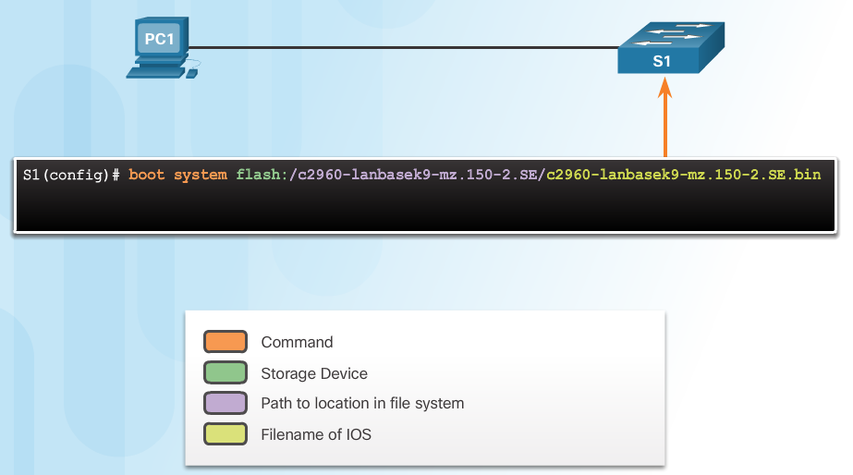
Configure a Switch with Initial Settings Switch Boot Sequence (Cont.)
The boot system command is use to set the BOOT environment variable.
Notes:
5.1 – Basic Switch Configuration
5.1.1 – Configure a Switch with Initial Settings
5.1.1.1 – Switch Boot Sequence

Slide 21
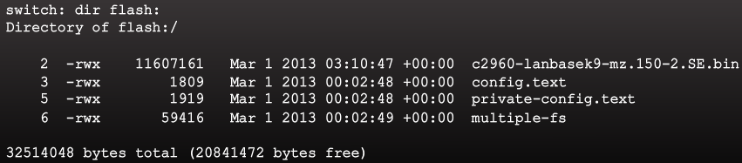
Configure a Switch with Initial Settings Recovering From a System Crash
The boot loader prompt can be accessed through a console connection to the switch:
1. Cable the PC to the switch console port.
2. Configure the terminal emulation software on the PC.
3. Unplug the switch power cord.
4. Reconnect the power cord and at the same time or within 15 seconds, press and hold the Mode button on the front of the switch until the System LED turns an amber color briefly and then turns a solid green.
The boot loader command prompt is switch: (instead of Switch>).
The commands available through the boot loader command prompt are limited.
Use the help command to display the available commands.
Notes:
5.1 – Basic Switch Configuration
5.1.1 – Configure a Switch with Initial Settings
5.1.1.2 – Recovering From a System Crash

Slide 22
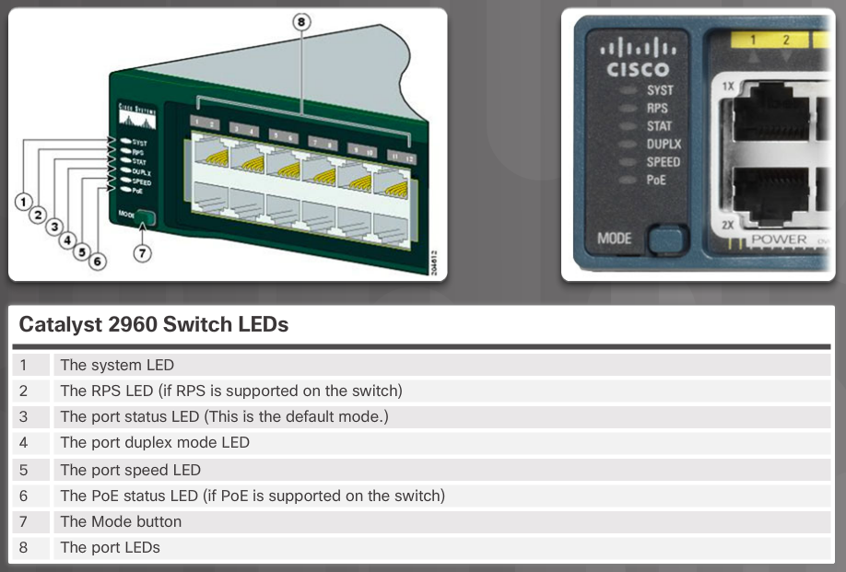
Configure a Switch with Initial Settings Switch LED Indicators
System LED shows if the switch has power applied.
Port LED states:
Off – no link or shut down
Green – link is present
Blinking green – data activity
Alternating green and amber – link fault
Amber – port is not sending data; common for first 30 seconds of connectivity or activation
Blinking amber – port is blocking to prevent a switch loop
Notes:
5.1 – Basic Switch Configuration
5.1.1 – Configure a Switch with Initial Settings
5.1.1.3 – Switch LED Indicators

Slide 23
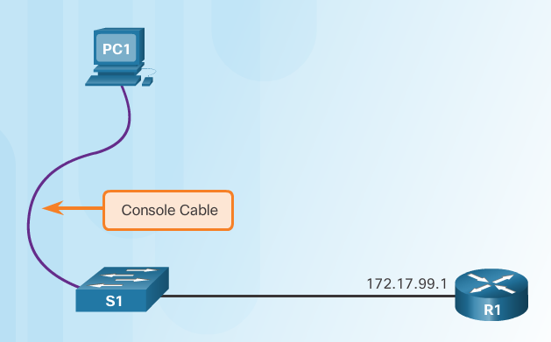
Configure a Switch with Initial Settings Preparing for Basic Switch Management
To configure a switch for remote access, the switch must be configured with an IP address, subnet mask, and default gateway.
One particular switch virtual interface (SVI) is used to manage the switch:
A switch IP address is assigned to an SVI.
By default the management SVI is controlled and configured through VLAN 1.
The management SVI is commonly called the management VLAN.
For security reasons, it is best practice to use a VLAN other than VLAN 1 for the management VLAN.
Remember that the switch console port is on the back of the switch.
Notes:
5.1 – Basic Switch Configuration
5.1.1 – Configure a Switch with Initial Settings
5.1.1.4 – Preparing for Basic Switch Management

Slide 24
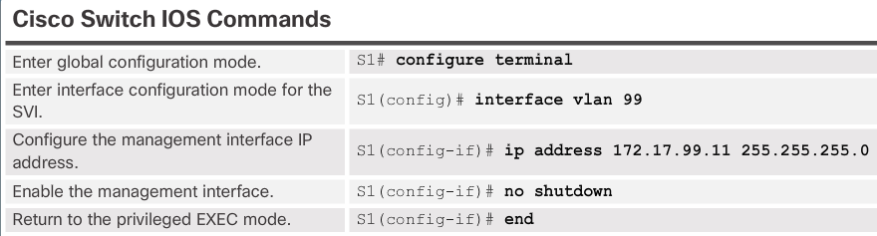
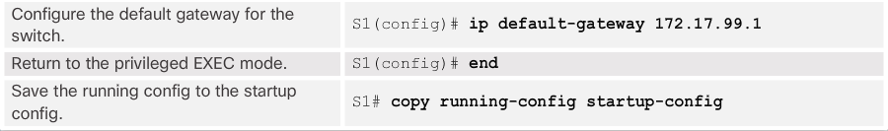
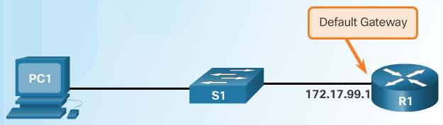
Configure a Switch with Initial Settings Configuring Basic Switch Management Access with IPv4
exit
Important Concept
The default gateway is the router address and is used by the switch to communicate with other networks.
Notes:
5.1 – Basic Switch Configuration
5.1.1 – Configure a Switch with Initial Settings
5.1.1.5 – Configuring Basic Switch Management Access with IPv4

Slide 25
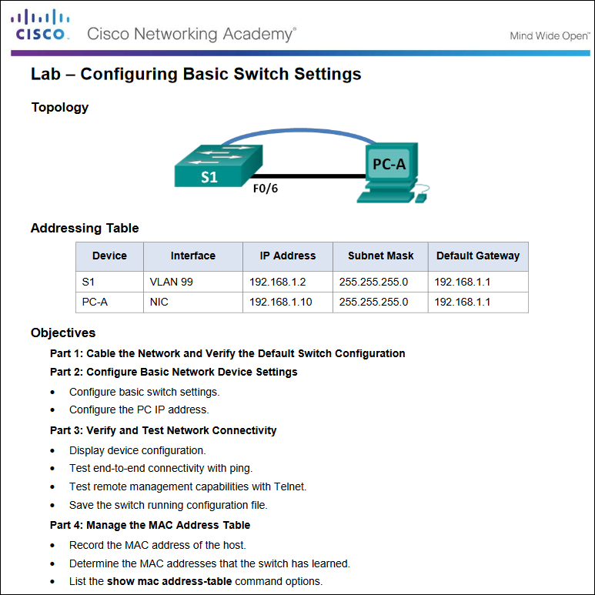
Configure a Switch with Initial Settings Basic Switch Configuration
Notes:
5.1 – Basic Switch Configuration
5.1.1 – Configure a Switch with Initial Settings
5.1.1.6 – Lab - Basic Switch Configuration

Slide 26
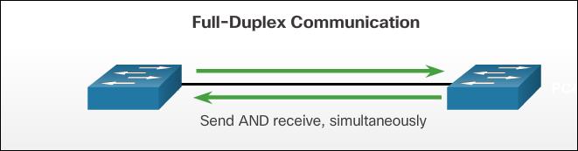
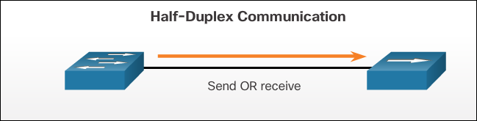
Configure Switch Ports Duplex Communication
Gigabit Ethernet and 10Gb Ethernet NICs require full-duplex connections to operate.
Bidirectional communication
Unidirectional communication
Notes:
5.1 – Basic Switch Configuration
5.1.2 – Configure Switch Ports
5.1.2.1 – Duplex Communication

Slide 27
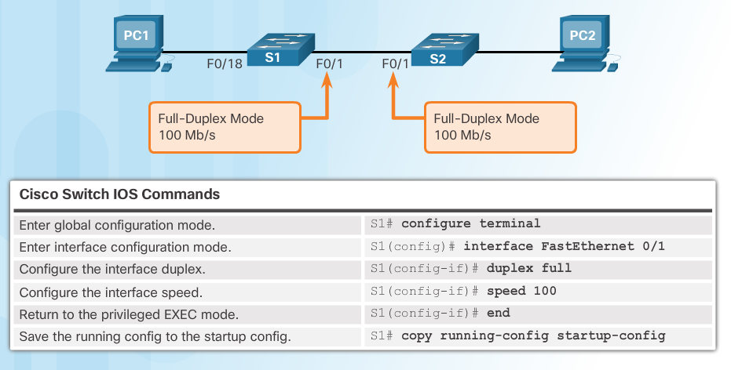
Configure Switch Ports Configure Switch Ports at the Physical Layer
Some switches have the default setting of auto for both duplex and speed.
Mismatched duplex and/or speed settings can cause connectivity issues.
Always check duplex and speed settings using the show interface interface_id command.
All fiber ports operate at one speed and are always full-duplex.
Notes:
5.1 – Basic Switch Configuration
5.1.2 – Configure Switch Ports
5.1.2.2 – Configure Switch Ports at the Physical Layer

Slide 28
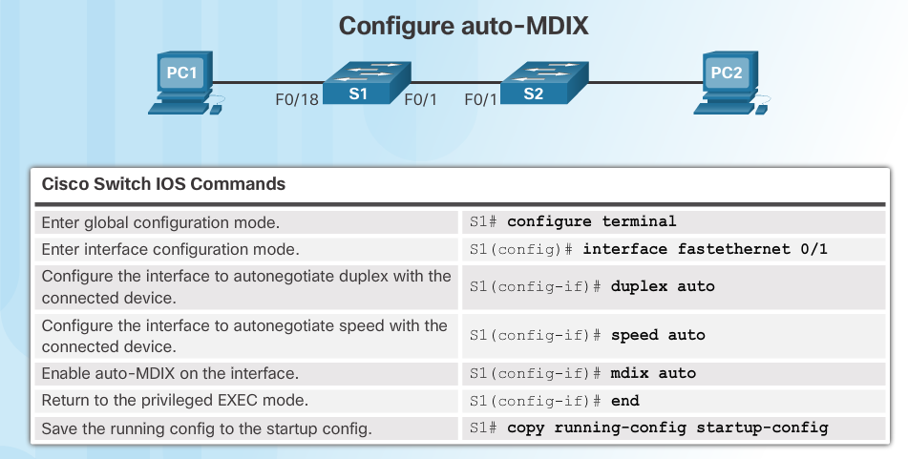
Configure Switch Ports Auto-MDIX
Some switches have the automatic medium-dependent interface crossover (auto-MDIX) feature that allows an interface to detect the required cable connection type (straight-through or crossover) and configure the connection appropriately.
Notes:
5.1 – Basic Switch Configuration
5.1.2 – Configure Switch Ports
5.1.2.3 – Auto-MDIX

Slide 29
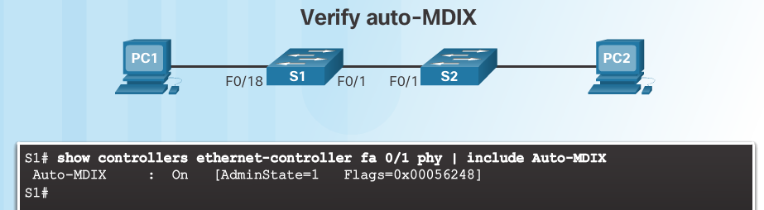
Configure Switch Ports Auto-MDIX (Cont.)
Use the show controllers Ethernet-controller command to verify auto-MDIX settings.
Notes:
5.1 – Basic Switch Configuration
5.1.2 – Configure Switch Ports
5.1.2.3 – Auto-MDIX (Cont.)

Slide 30
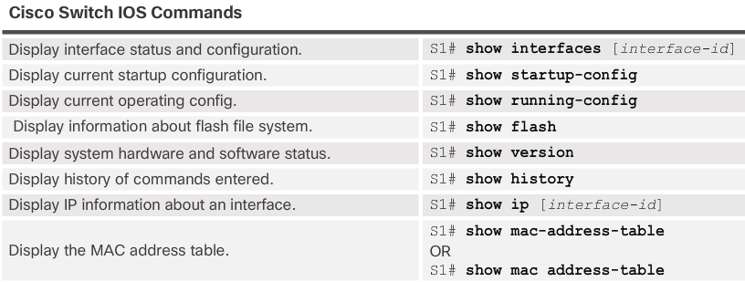
Configure Switch Ports Verifying Switch Port Configuration
Notes:
5.1 – Basic Switch Configuration
5.1.2 – Configure Switch Ports
5.1.2.4– Verifying Switch Port Configuration

Slide 31
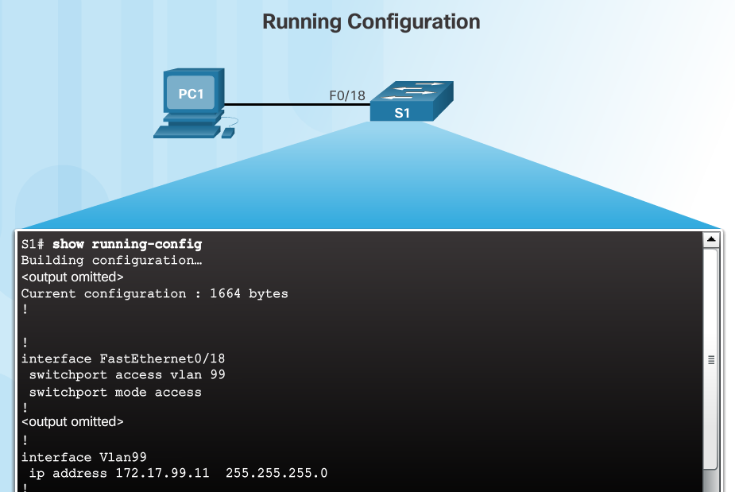
Configure Switch Ports Verifying Switch Port Configuration (Cont.)
Notes:
5.1 – Basic Switch Configuration
5.1.2 – Configure Switch Ports
5.1.2.4– Verifying Switch Port Configuration (Cont.)

Slide 32
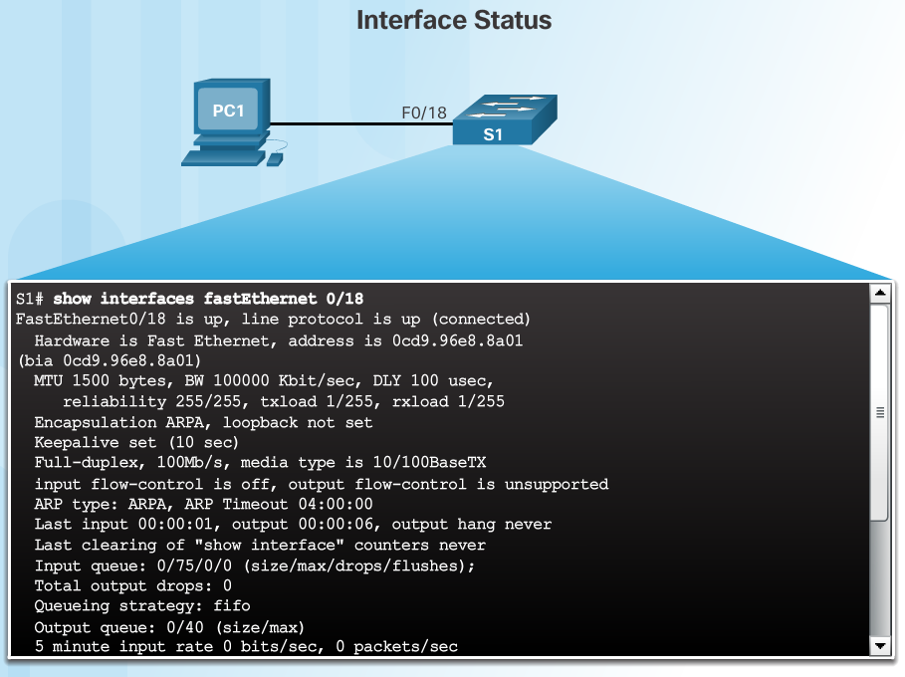
Configure Switch Ports Verifying Switch Port Configuration (Cont.)
Layer 1 OK
Layer 2 OK
Notes:
5.1 – Basic Switch Configuration
5.1.2 – Configure Switch Ports
5.1.2.4– Verifying Switch Port Configuration (Cont.)

Slide 33
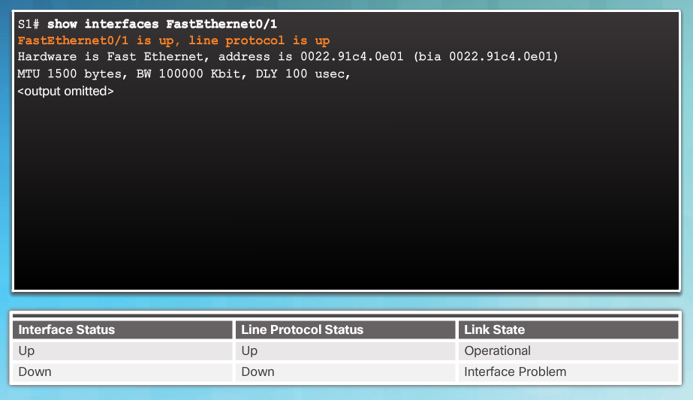
Configure Switch Ports Network Access Layer Issues
Use the show interfaces command to detect common media issues.
The first parameter refers to Layer 1, the physical layer, and indicates if the interface is receiving a carrier detect signal.
The second parameter (protocol status) refers to the data link layer and indicates whether the data link layer protocol has been configured correctly and keepalives are being received.
Notes:
5.1 – Basic Switch Configuration
5.1.2 – Configure Switch Ports
5.1.2.5 – Network Access Layer Issues

Slide 34
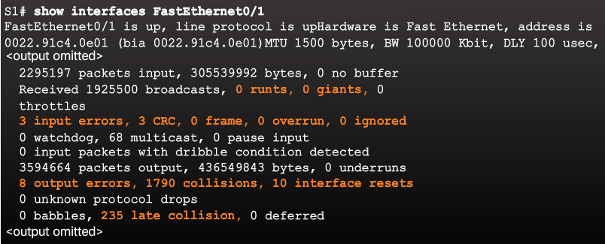
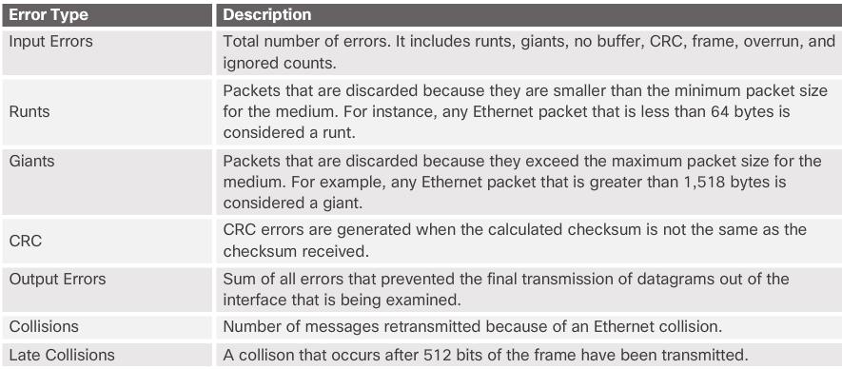
Configure Switch Ports Network Access Layer Issues (Cont.)
Notes:
5.1 – Basic Switch Configuration
5.1.2 – Configure Switch Ports
5.1.2.5 – Network Access Layer Issues (Cont.)

Slide 35
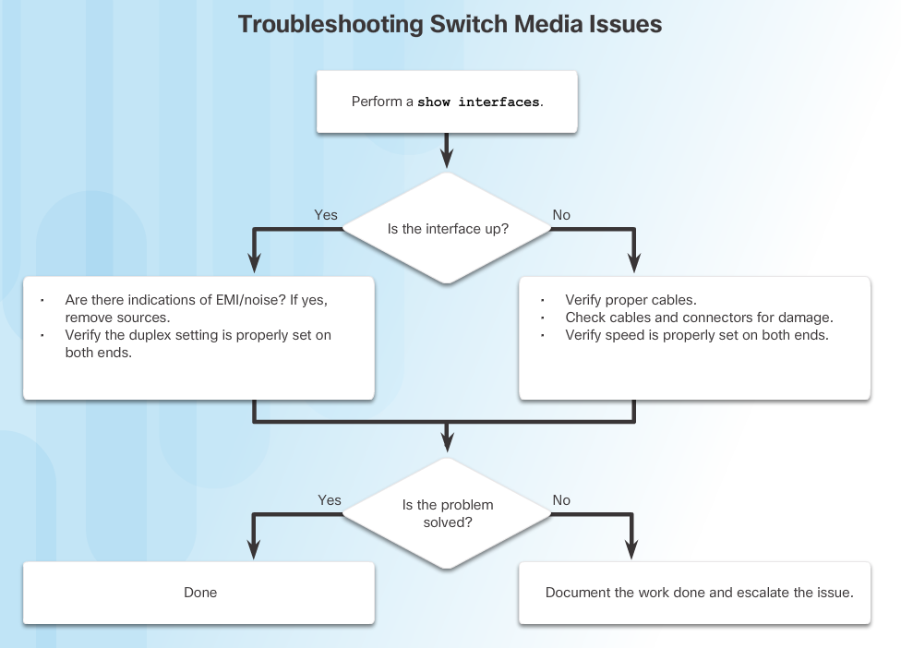
Configure Switch Ports Troubleshooting Network Access Layer Issues
Notes:
5.1 – Basic Switch Configuration
5.1.2 – Configure Switch Ports
5.1.2.6– Troubleshooting Network Access Layer Issues

Slide 36
5.2 Switch Security
Notes:
5 - Switch Configuration
5.2 – Switch Security

Slide 37
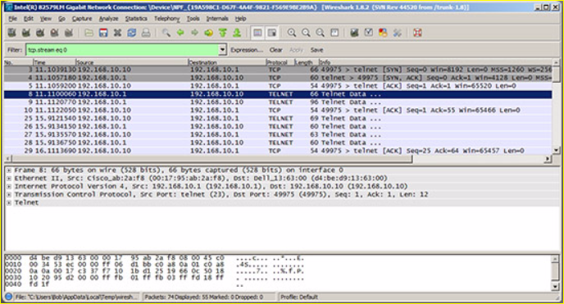
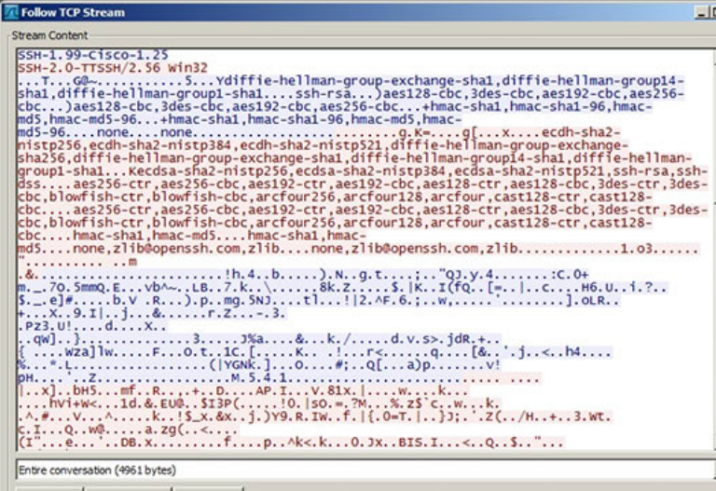
Secure Remote Access SSH Operation
Secure Shell (SSH)
An alternative protocol to Telnet. Telnet uses unsecure plaintext of the username and password as well as the data transmitted.
SSH is more secure because it provides an encrypted management connection.
Wireshark Capture of Telnet
Wireshark Capture of SSH
Notes:
5.2 – Switch Security
5.2.1 – Secure Remote Access
5.2.1.1 – SSH Operation

Slide 38
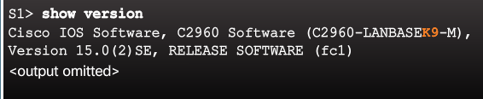
Secure Remote Access SSH Operation (Cont.)
A switch must have an IOS version (k9 at the end of the IOS file name) that includes cryptographic capabilities in order to configure and use SSH.
Use the show version command to see the IOS version.
Notes:
5.2 – Switch Security
5.2.1 – Secure Remote Access
5.2.1.1 – SSH Operation (Cont.)

Slide 39
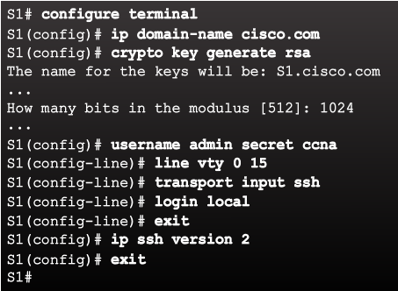
Secure Remote Access Configuring SSH
Commonly forgotten command that is used in key generation
Verify SSH support.
Configure the IP domain name.
Generate RSA key pairs.
Configure user authentication.
Configure the vty lines.
Enable SSH version 2.
Default is to accept both Telnet and SSH (transport input all)
The login local command forces the use of the local database for username/ password.
Notes:
5.2 – Switch Security
5.2.1 – Secure Remote Access
5.2.1.2 – Configuring SSH

Slide 40
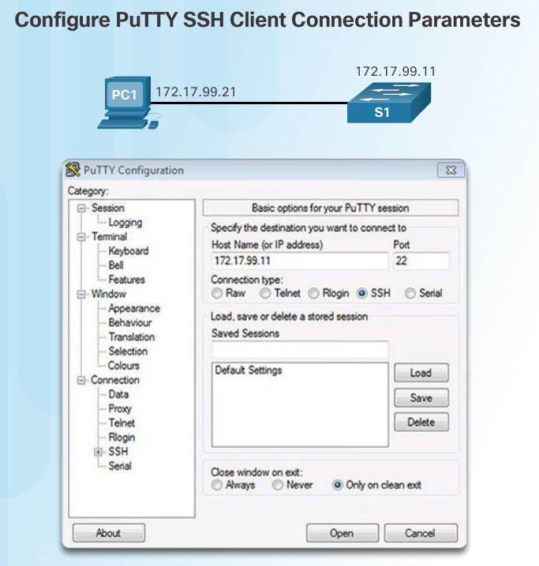
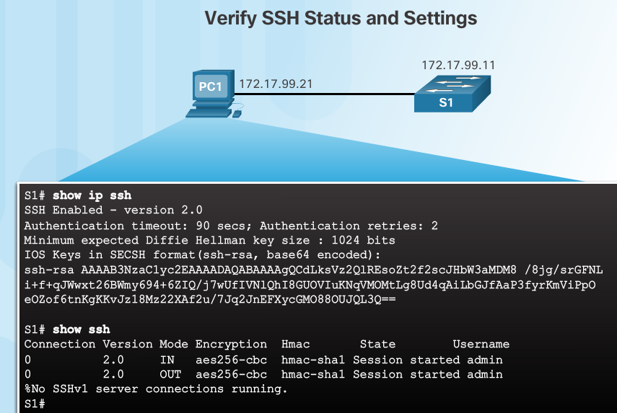
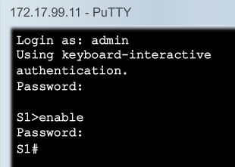
Secure Remote Access Verifying SSH
On the PC, connect to the switch using SSH.
Switch IP address
The PC is using SSH to communicate and issue commands on the switch.
Notes:
5.2 – Switch Security
5.2.1 – Secure Remote Access
5.2.1.3 – Verifying SSH

Slide 41
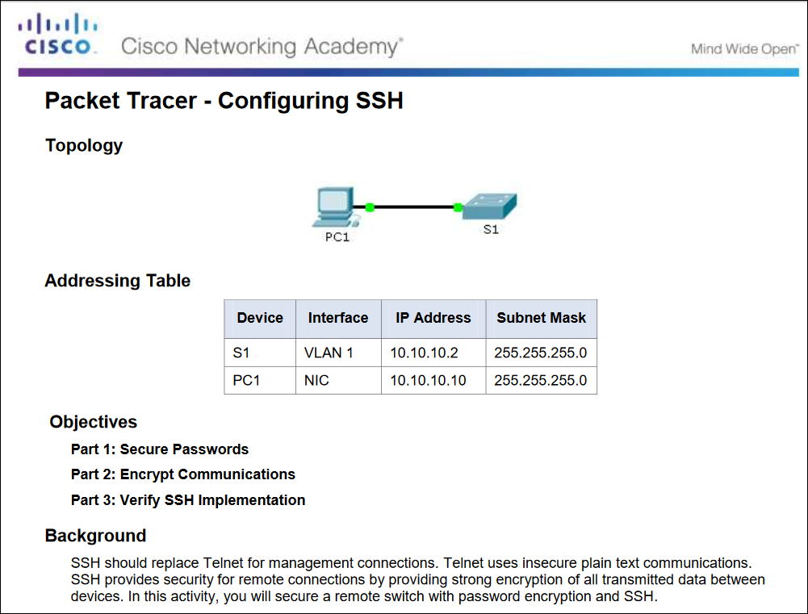
Secure Remote Access Packet Tracer – Configuring SSH
Notes:
5.2 – Switch Security
5.2.1 – Secure Remote Access
5.2.1.4 – Packet Tracer – Configuring SSH

Slide 42
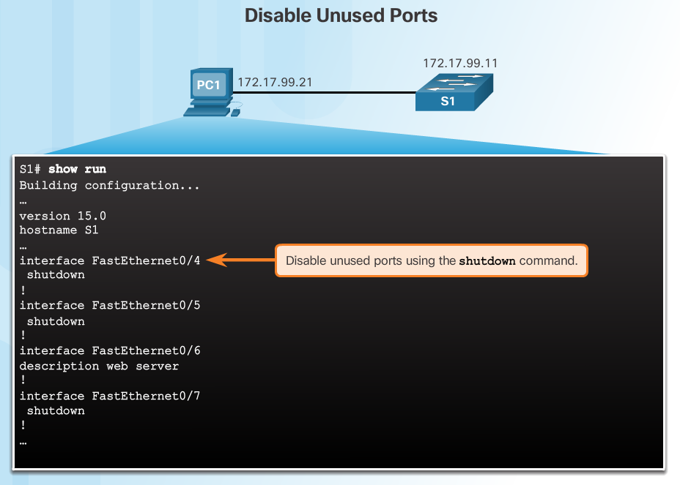
Switch Port Security Secure Unused Ports
The interface range command can be used to apply a configuration to several switch ports at one time.
Notes:
5.2 – Switch Security
5.2.2 – Switch Port Security
5.2.2.1 – Secure Unused Ports

Slide 43
Switch Port Security Port Security: Operation
Port security limits the number of valid MAC addresses allowed to transmit data through a switch port.
If a port has port security enabled and an unknown MAC address sends data, the switch presents a security violation.
Default number of secure MAC addresses allowed is 1.
Methods use to configure MAC addresses within port security:
Static secure MAC addresses – manually configure
switchport port-security mac-address mac-address
Dynamic secure MAC addresses – dynamically learned and removed if the switch restarts
Sticky secure MAC addresses – dynamically learned and added to the running configuration (which can later be saved to the startup-config to permanently retain the MAC addresses)
switchport port-security mac-address sticky mac-address
Note: Disabling sticky learning converts sticky MAC addresses to dynamic secure addresses and removes them from the running-config.
Notes:
5.2 – Switch Security
5.2.2 – Switch Port Security
5.2.2.2 – Port Security: Operation

Slide 44
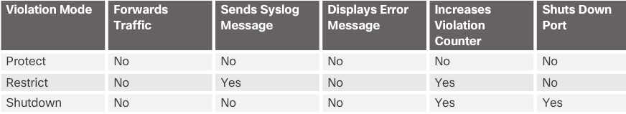
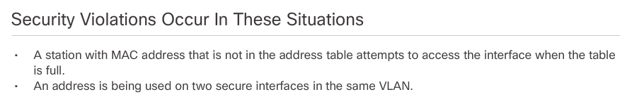
Switch Port Security Port Security: Violation Modes
Protect – data from unknown source MAC addresses are dropped; a security notification IS NOT presented by the switch
Restrict - data from unknown source MAC addresses are dropped; a security notification IS presented by the switch and the violation counter increments.
Shutdown – (default mode) interface becomes error-disabled and port LED turns off. The violation counter increments. Issues the shutdown and then the no shutdown command on the interface to bring it out of the error-disabled state.
Notes:
5.2 – Switch Security
5.2.2 – Switch Port Security
5.2.2.3 – Port Security: Violation Modes

Slide 45
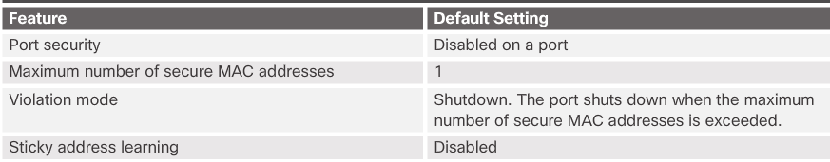
Switch Port Security Port Security: Configuring
Notes:
5.2 – Switch Security
5.2.2 – Switch Port Security
5.2.2.4 – Port Security: Configuring

Slide 46
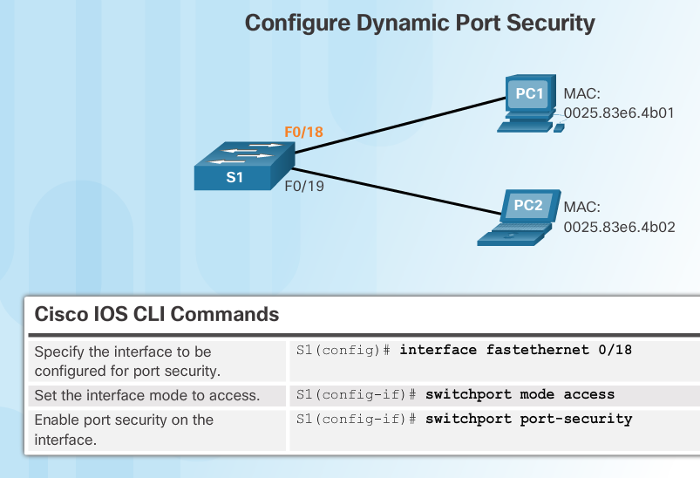
Switch Port Security Port Security: Configuring (Cont.)
Before configuring port-security features, place the port in access mode and use the switchport port-security interface configuration command to enable port security on an interface.
Most common configuration error is to forget this command!
Notes:
5.2 – Switch Security
5.2.2 – Switch Port Security
5.2.2.4 – Port Security: Configuring (Cont.)

Slide 47
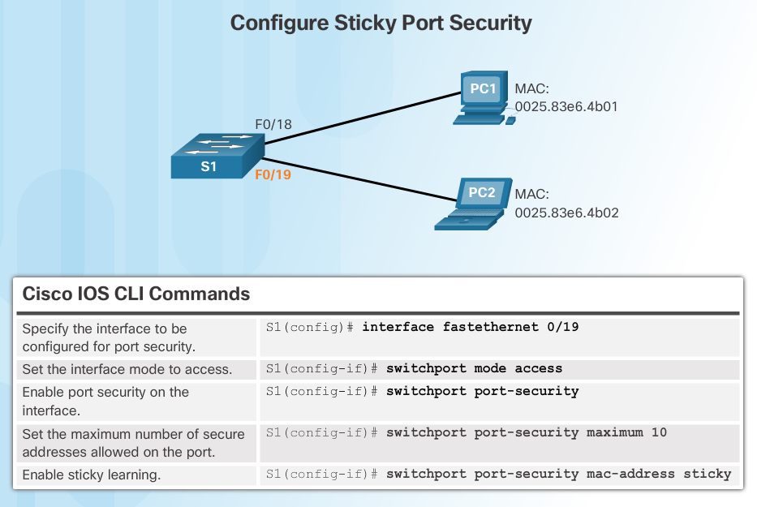
Switch Port Security Port Security: Configuring (Cont.)
Most common configuration error is to forget this command!
Notes:
5.2 – Switch Security
5.2.2 – Switch Port Security
5.2.2.4 – Port Security: Configuring (Cont.)

Slide 48
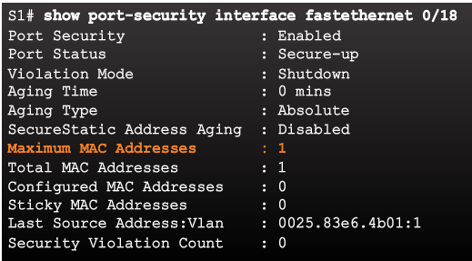
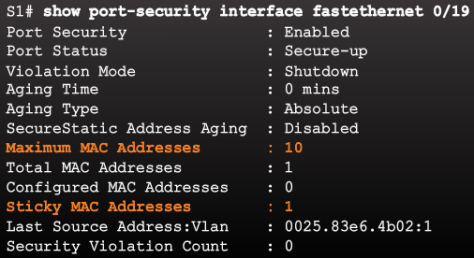
Switch Port Security Port Security: Verifying
Use the show port-security interface command to verify the maximum number of MAC addresses allowed on a particular port and how many of those addresses were learned dynamically using sticky.
Dynamic
Sticky
Notes:
5.2 – Switch Security
5.2.2 – Switch Port Security
5.2.2.5 – Port Security: Verifying

Slide 49
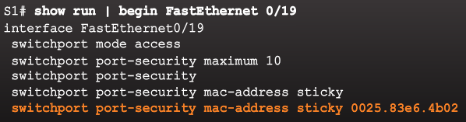
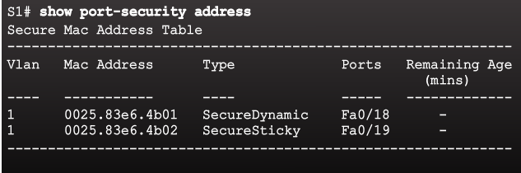
Switch Port Security Port Security: Verifying (Cont.)
Use the show running-config command to see learned MAC addresses added to the configuration.
The show port-security address command shows how MAC addresses were learned on a particular port.
Notes:
5.2 – Switch Security
5.2.2 – Switch Port Security
5.2.2.5 – Port Security: Verifying (Cont.)

Slide 50
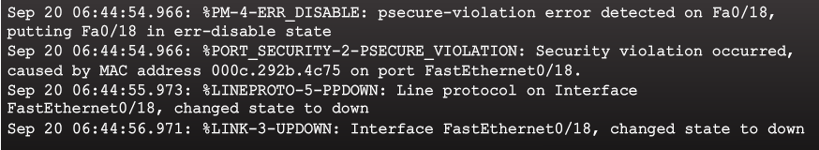
Switch Port Security Ports in Error Disabled State
Switch console messages display when a port security violation occurs. Notice the port link status changes to down.
Notes:
5.2 – Switch Security
5.2.2 – Switch Port Security
5.2.2.6 – Ports in Error Disabled State

Slide 51
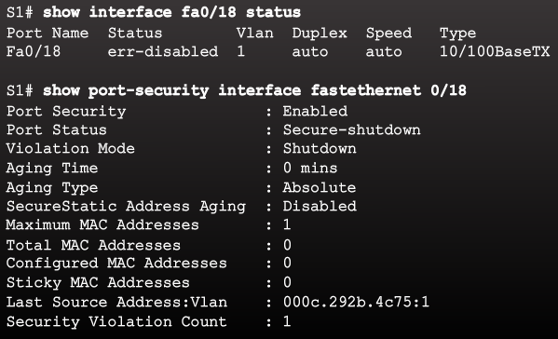
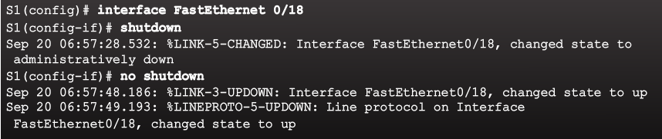
Switch Port Security Ports in Error Disabled State (Cont.)
Check the port status and the port security settings.
Do not re-enable a port until the security threat is investigated and eliminated.
Notice that you must first shut the port down and then issue the no shutdown command in order to use the particular port again after a security violation has occurred.
Notes:
5.2 – Switch Security
5.2.2 – Switch Port Security
5.2.2.6 – Ports in Error Disabled State (Cont.)

Slide 52
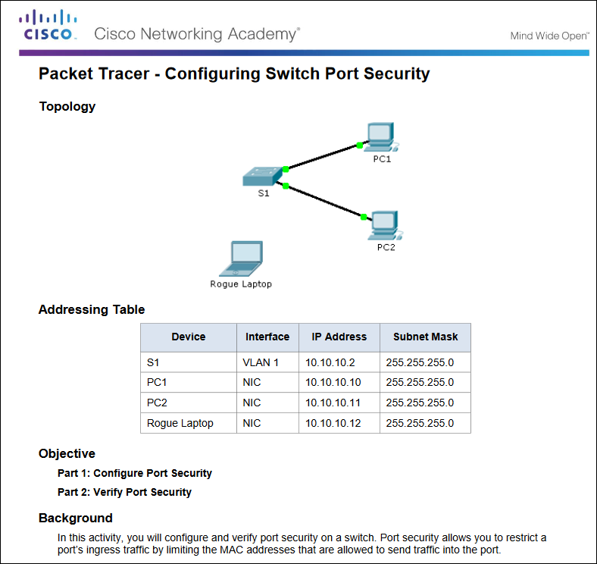
Secure Remote Access Packet Tracer – Configuring Switch Port Security
Notes:
5.2 – Switch Security
5.2.2 – Switch Port Security
5.2.2.7 – Packet Tracer – Configuring Switch Port Security

Slide 53
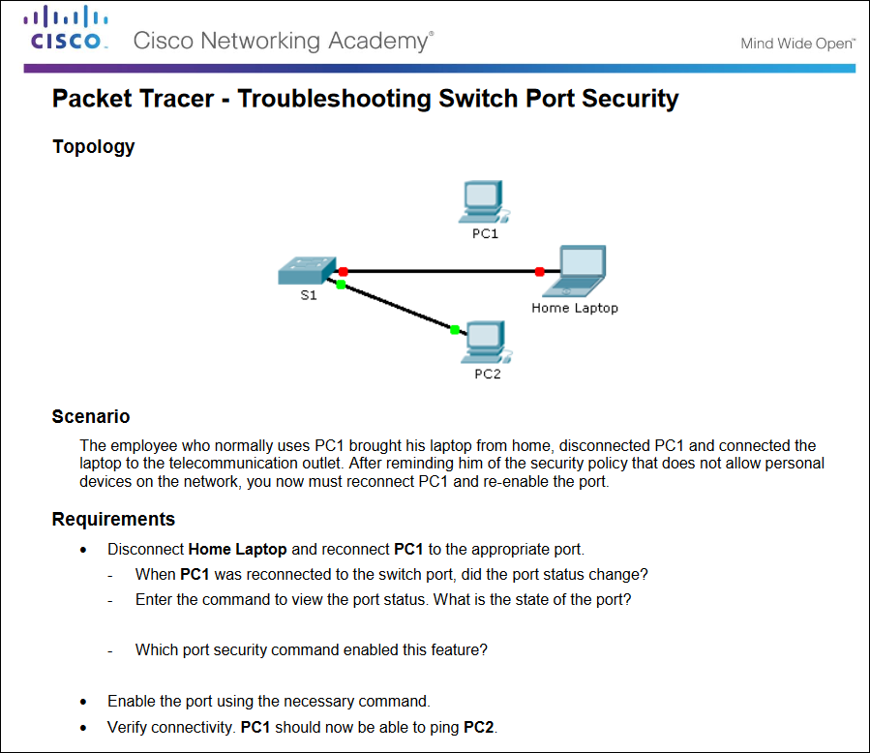
Secure Remote Access Packet Tracer – Troubleshooting Switch Port Security
Notes:
5.2 – Switch Security
5.2.2 – Switch Port Security
5.2.2.8 – Packet Tracer – Troubleshooting Switch Port Security

Slide 54
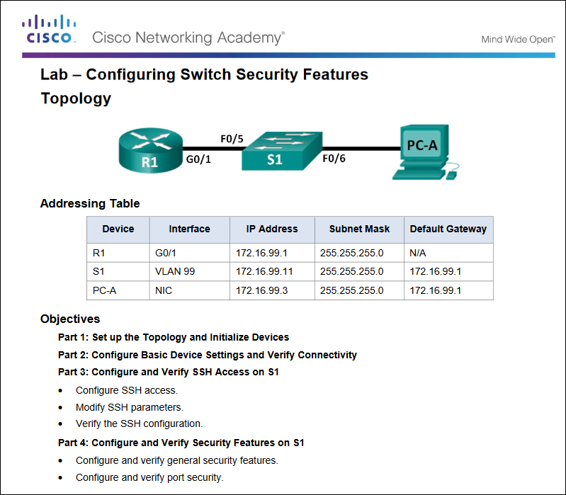
Secure Remote Access Packet Tracer – Configuring Switch Security Features
Notes:
5.2 – Switch Security
5.2.2 – Switch Port Security
5.2.2.9 – Lab – Configuring Switch Security Features

Slide 55
5.3 Chapter Summary
Notes:
5 - Switch Configuration
5.3 – Summary

Slide 56
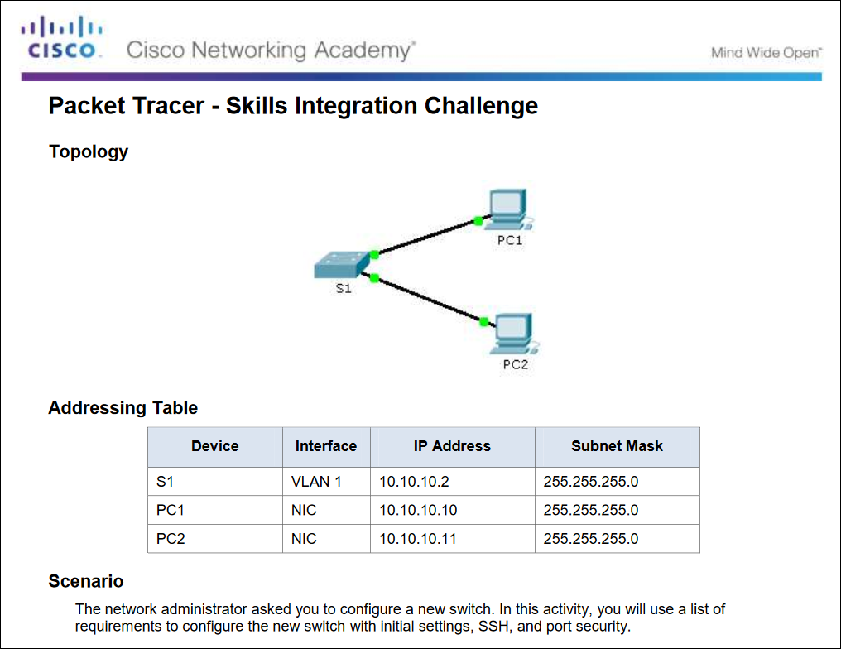
Conclusion Packet Tracer - Skills Integration Challenge
Notes:
5.3 – Summary
5.3.1 – Conclusion
5.3.1.2 – Packet Tracer - Skills Integration Challenge

Slide 57
Conclusion Chapter 5: Switch Configuration
Configure basic switch settings to meet network requirements.
Configure a switch using security best practices in a small to medium-sized business network.
Notes:
5.3 – Summary
5.3.1 – Conclusion
5.3.1.3 – Switch Configuration

Slide 58
Section 5.1 New Terms and Commands
POST Boot loader boot system command show boot command switch: prompt Mode button System LED Port LED SVI VLAN Management VLAN interface vlan command vlan command name command | Full-duplex Half-duplex Port speed duplex command speed command mdix command show interfaces command SSH configuration ip domain-name command crypto key generate rsa command transport input local command username secret command ip ssh version 2 command | login local command show ip ssh command Unused ports Port security switchport mode access command switchport port-security command switchport port-security maximum command switchport port-security mac-address sticky command show port-security interface command show port-security address command
Notes:
Chapter 5 - New Terms and Commands

